Slide 1
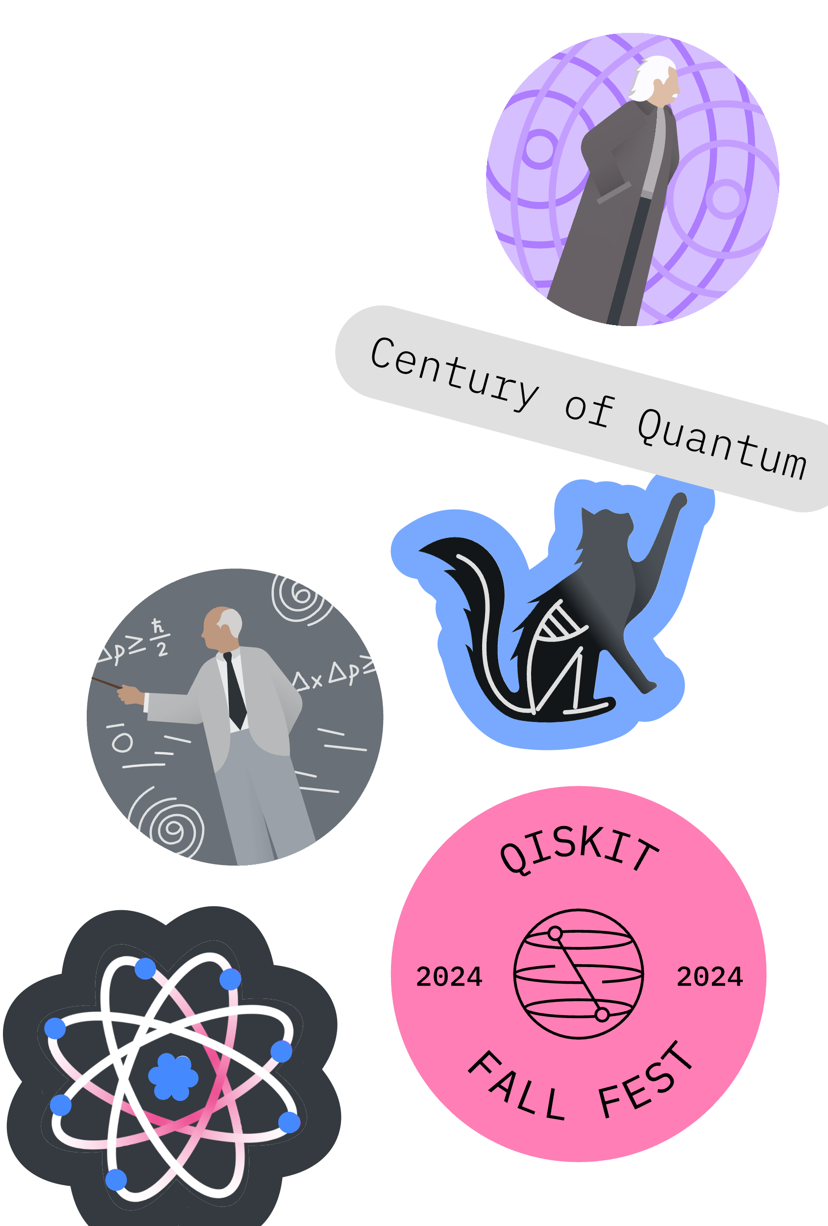

Marketing Kit & Best Practices
Qiskit Fall Fest 2025
Sanskriti Deva Associate Product Marketing Manager, Quantum IBM

Slide 2

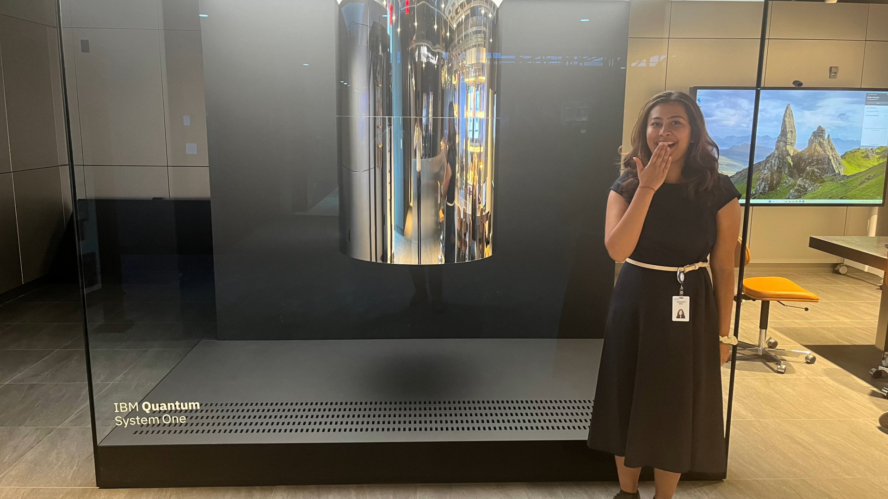

About Me
Former Qiskit Fall Fest Organizer Turned IBMer
Graduated '24 from NC State University

Slide 3

Marketing Channels
Local
Local colleges & academic institutions
Public Events Boards
Community Libraries
Co-Working Spaces/Tech Incubators
STEM nonprofits/organizations
Community Newsletters
Community Bulletins
On-Campus
Department Mailing Lists
(Computer Science, Engineering, Physics, etc)
Student Organizations
Campus TV/Radio Station
Bulletin Boards
Announcements in relevant classes
Residence Halls/RAs
Chalkboard Advertising
Library Announcement Board
Social Media
LinkedIn: IBM Quantum can engage with it, just tag us @IBM Quantum and send us the link.
Instagram
Tiktok
Discord
Facebook Groups
Twitter/X

Slide 4
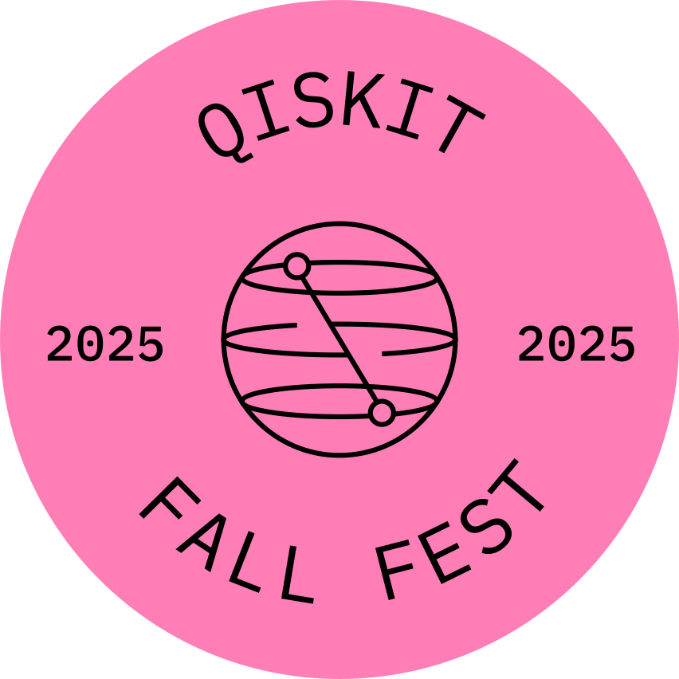
Social Media Best Practices
Use our social templates/graphics, and make it your own!
Add pictures, one of our graphics, a custom image, or engaging videos.
Tag @IBM Quantum on LinkedIn and send us the link so we can engage with it and repost.
Ask your university, department, & community pages to repost.
Find our social template and graphics here.

Slide 5
LinkedIn Post Template
We’re excited to announce that in honor of the @International Year of Quantum [Your University/Organization Name] will be hosting a Qiskit Fall Fest 2025 event this fall, supported by @IBM Quantum.
Qiskit Fall Fest is a student-led, worldwide series of events that brings people together to explore and learn about quantum computing.
⚛️ Our event will feature: [insert one-line event overview here – e.g., hands-on workshops, coding challenges, or guest talks]
📅 Date: [Insert your event date(s)] 📍 Location: [Insert campus or “virtual”]
This is an exciting moment. The quantum industry is accelerating quickly, and the quantum industry is on track to achieve quantum advantage by 2026. We get to be part of that journey through Qiskit Fall Fest. We’ll be using Qiskit, the world’s most performant quantum software development kit, and running circuits on utility-scale hardware built to return meaningful results.
The future of quantum isn’t built alone, it’s built by investing in students and local communities, sharing knowledge, and empowering the next generation of quantum leaders.
I’m proud to build the quantum future with [my campus/my local community] and can’t wait to learn, build, and grow together. Whether you’re brand new to quantum or already exploring the field, there’s a place for you here. So come build skills and join this global community.
#QiskitFallFest #QuantumComputing #IBMQuantum #FallFest2025 #QuantumTech #Qiskit #STEM #QuantumFuture #StudentLeadership

Slide 6
Thanks! Questions?

